Slide 1
Week 8-9
Object Detection

Slide 2
Overview
Two-Stage:
R-CNN
Fast R-CNN
Faster R-CNN
Mask R-CNN
One-Stage:
YOLO v1-YOLO v3
SSD
RetinaNet
Combine:
1. RefineDet
Component:
1. Relation Net
Transformer based:
1. DETR

Slide 3
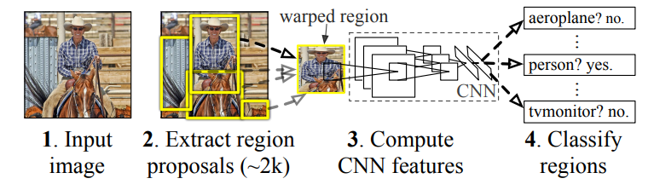
R-CNN
Selective Search
AlexNet
Stage 1
Stage 2

Slide 4
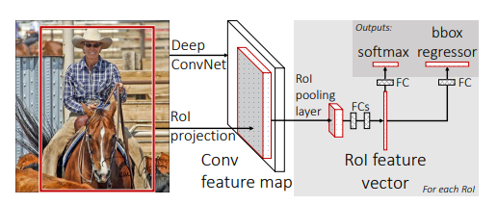
Fast R-CNN
Architecture
RoI pooling layer
Loss function

Slide 5
Architecture
RoI projection
image
ConvNet
Selective Search
Feature map

Slide 6
RoI pooling layer
Max pooling
Same size
RoI feature map
RoI pooling layer

Slide 7



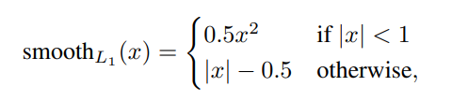
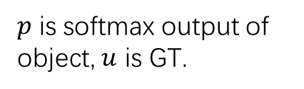
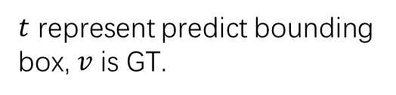
Loss function
$p$ is softmax output of object, $u$ is GT.
$t$ represent predict bounding box, $v$ is GT.

Slide 8
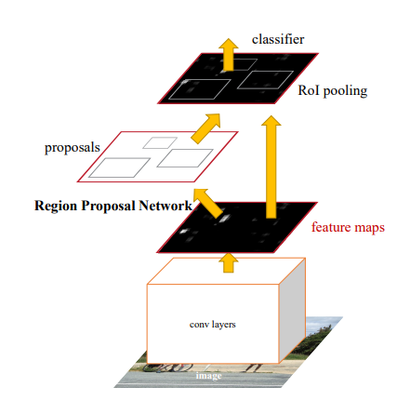
Faster R-CNN
Architecture
RPN
Loss function

Slide 9
Architecture
Proposal RoI from feature map by RPN.

Slide 10
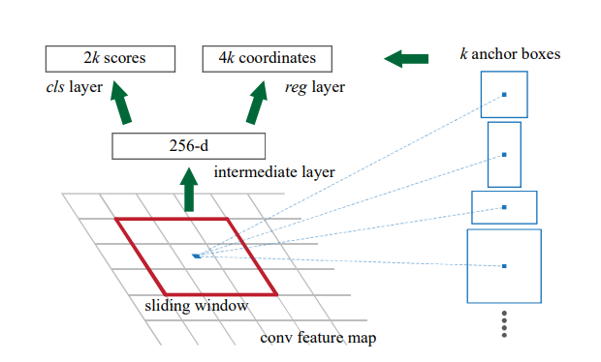
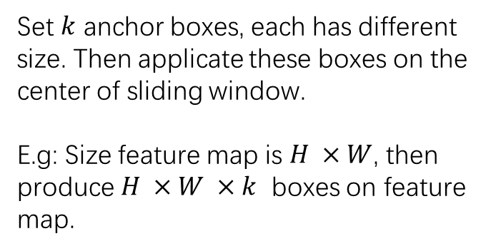
RPN
Set $k$ anchor boxes, each has different size. Then applicate these boxes on the center of sliding window.
E.g: Size feature map is $H ×W$, then produce $H ×W ×k$ boxes on feature map.

Slide 11
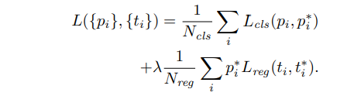

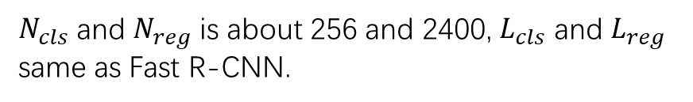
Loss function
$N_{cls}$ and $N_{reg}$ is about 256 and 2400, $L_{cls}$ and $L_{reg}$ same as Fast R-CNN.
If objective cls is true, $p^{∗}=1$, otherwise.
Balance parameter

Slide 12
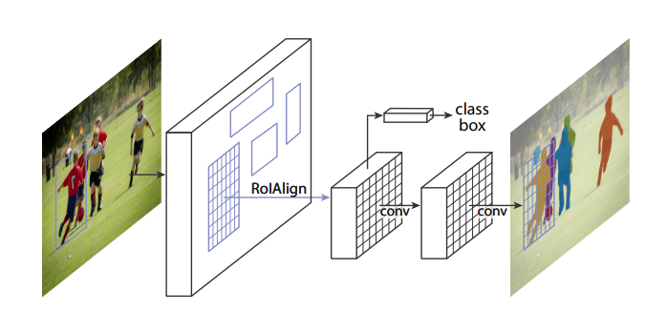
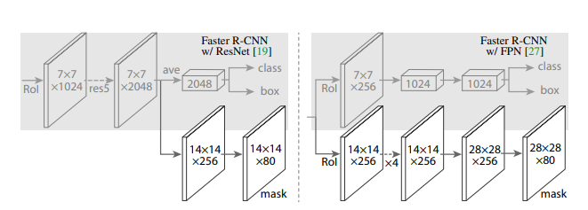
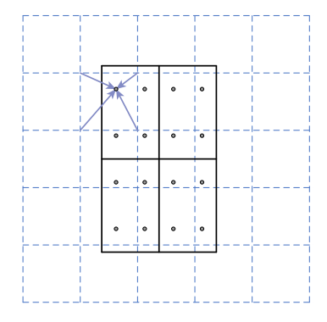
Mask R-CNN
Head
RoIAlign

Slide 13
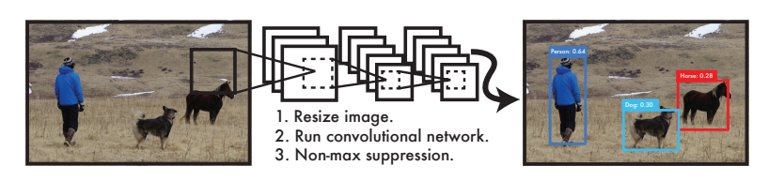
YOLO v1
Grid cell
Architecture

Slide 14
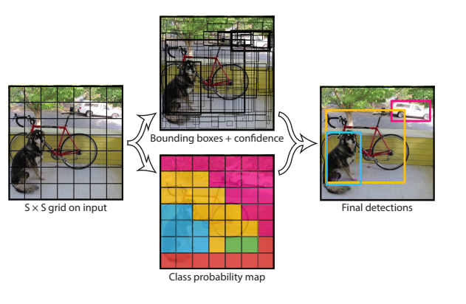
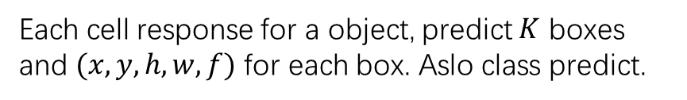
Grid cell
Each cell response for a object, predict $K$ boxes and $(x, y, h, w, f)$ for each box. Aslo class predict.

Slide 15
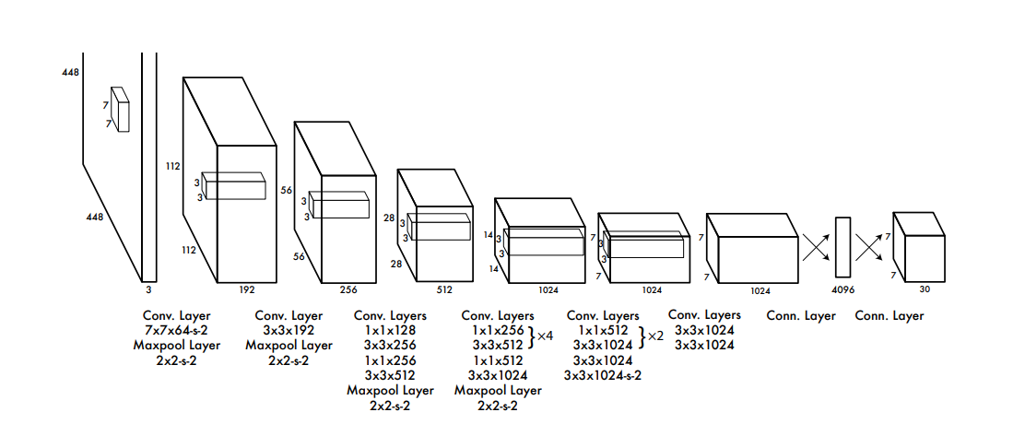

Architecture
Predictions: $S×S×(5∗B+C)$

Slide 16
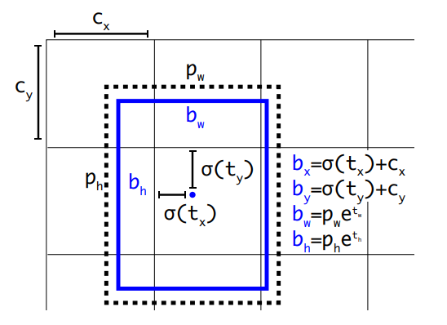
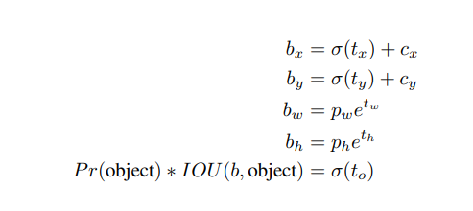
YOLO v2
High resolution
Anchor boxes
Anchor cluster
Anchor Predict
Improvements
Architecture
Dash: prior
Predict

Slide 17
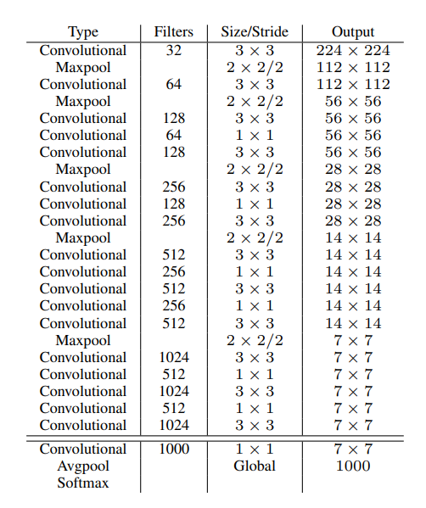
Architecture
Removed FC layer

Slide 18
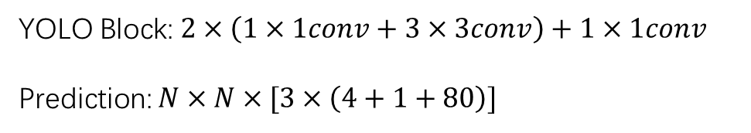
YOLO v3
YOLO Block
1x1conv -> upsample -> concat
YOLO Block
1x1conv -> upsample -> concat
YOLO Block
YOLO Block: $2×\left(1×1conv+3×3conv\right)+1×1conv$
Prediction: $N×N×[3×\left(4+1+80\right)]$

Slide 19
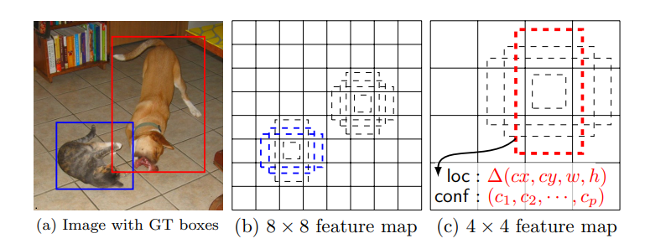
SSD
Architecture
Anchor
Coordinate

Slide 20
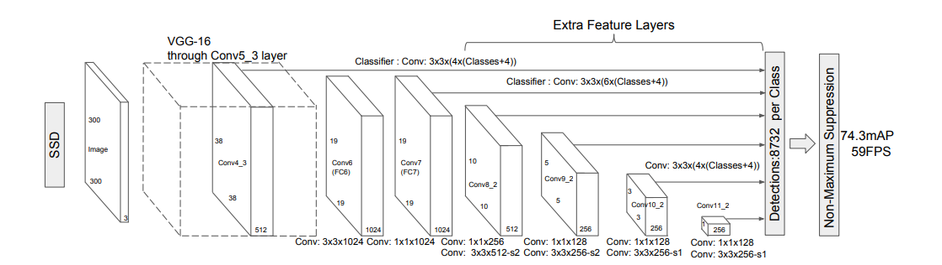
Architecture

Slide 21

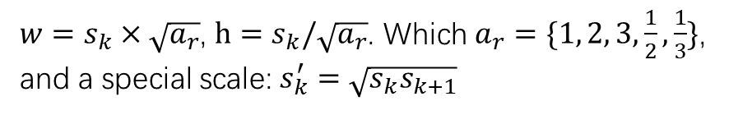
Anchor
$w=s_{k}×\sqrt{a_{r}}$, $h=s_{k}/\sqrt{a_{r}}$. Which $a_{r}=\{1, 2, 3,\frac{1}{2},\frac{1}{3}\}$, and a special scale: $s_{k}^{′}=\sqrt{s_{k}s_{k+1}}$
0.9
0.2
Anchor size scale:

Slide 22
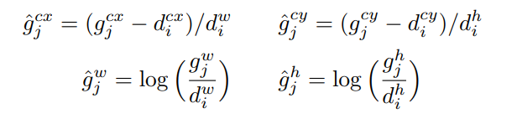
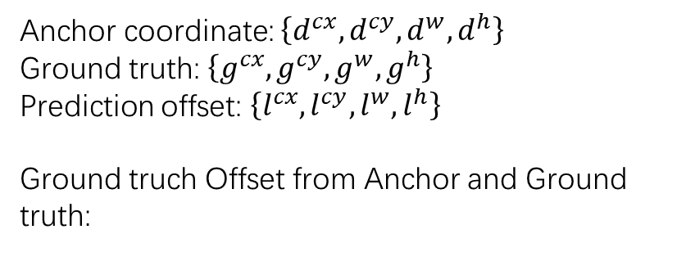
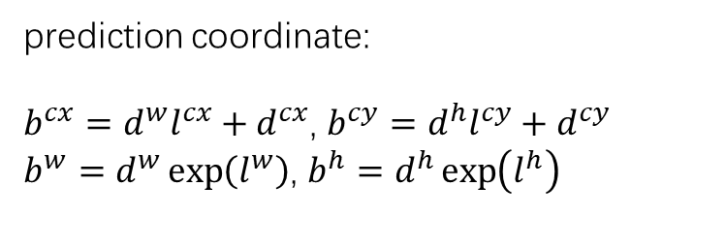
Coordinate
Anchor coordinate: $\left\{d^{cx},d^{cy},d^{w},d^{h}\right\}$
Ground truth: $\left\{g^{cx},g^{cy},g^{w},g^{h}\right\}$
Prediction offset: $\left\{l^{cx},l^{cy},l^{w},l^{h}\right\}$
Ground truch Offset from Anchor and Ground truth:
prediction coordinate:
$b^{cx}=d^{w}l^{cx}+d^{cx}$, $b^{cy}=d^{h}l^{cy}+d^{cy}$
$b^{w}=d^{w}\exp\left(l^{w}\right)$, $b^{h}=d^{h}\exp\left(l^{h}\right)$

Slide 23
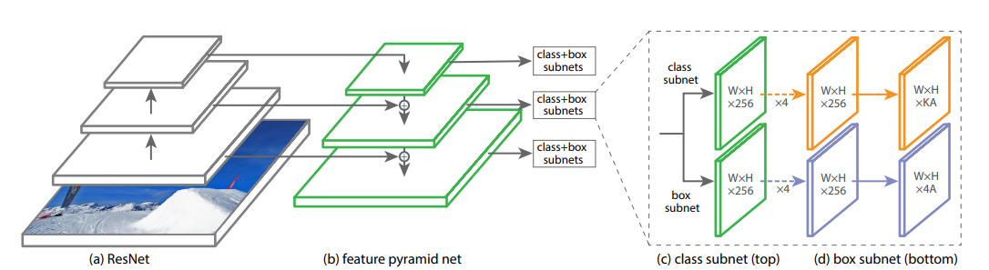
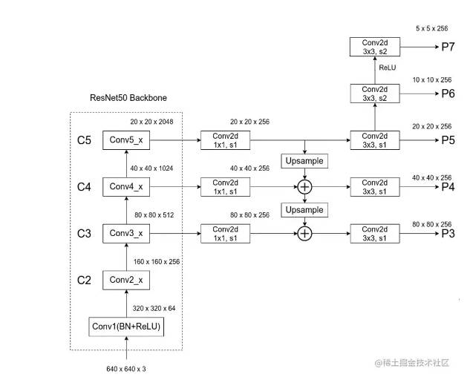
RetinaNet
Architecture
Loss function

Slide 24









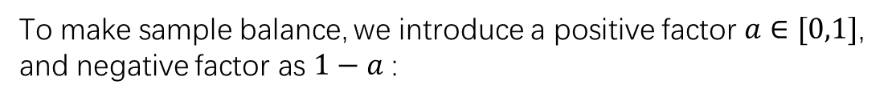
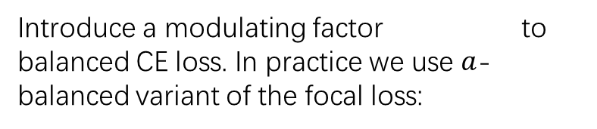
Loss function
Further, We propose the focal loss function:
First, the CE loss:
We define $p_{t}$:
Introduce a modulating factor to balanced CE loss. In practice we use $a$-balanced variant of the focal loss:
Then, rewrite CE loss:
1
To make sample balance, we introduce a positive factor $a∈[0,1]$, and negative factor as $1−a$ :
2
3

Slide 25
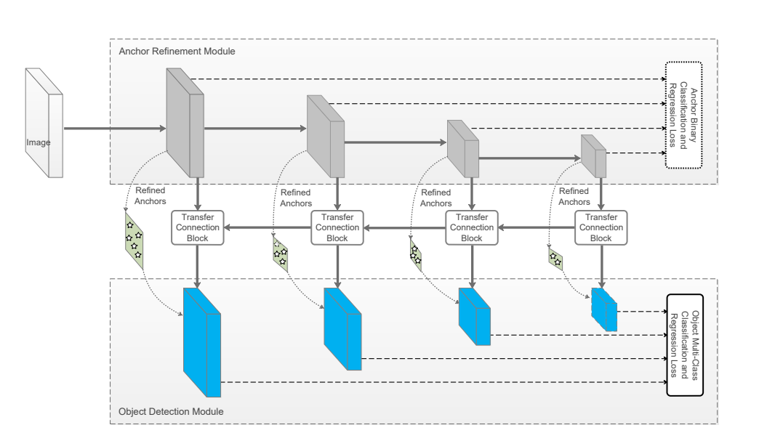
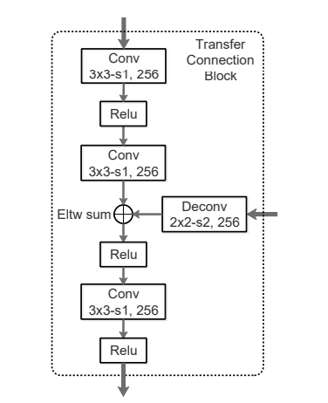
RefineDet
ARM: predict is obj or not, and refine anchor.
ODM: receive feature map and refined anchors from ARM, to predict coordinate and class label.

Slide 26
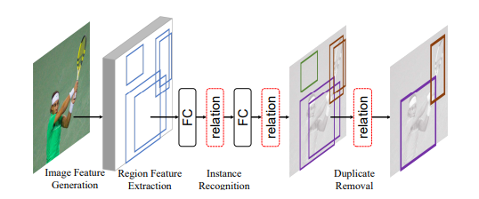
Relation Net
Theory
Application

Slide 27
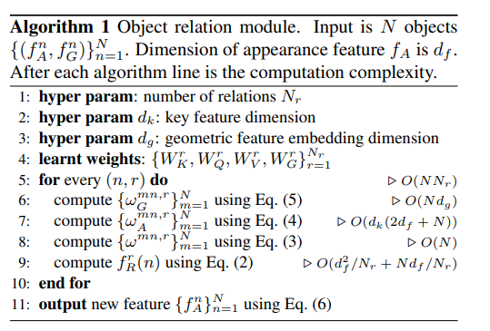




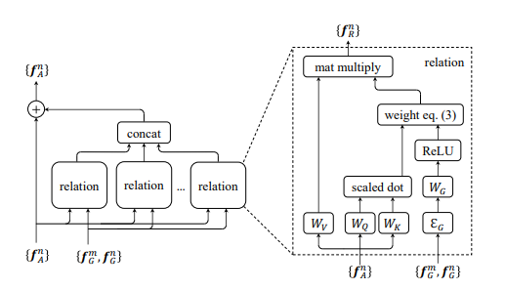


Theory
Relation weight
Appearance weight
Geometry weight
Embedding

Slide 28
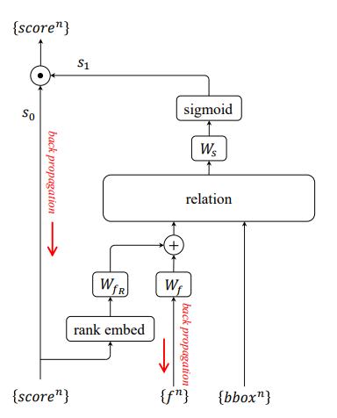
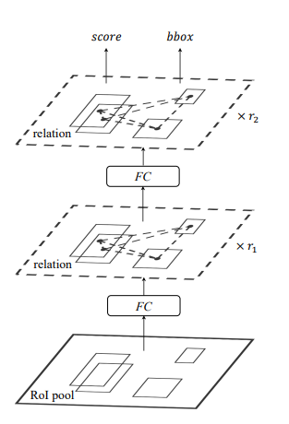
Application

Slide 29
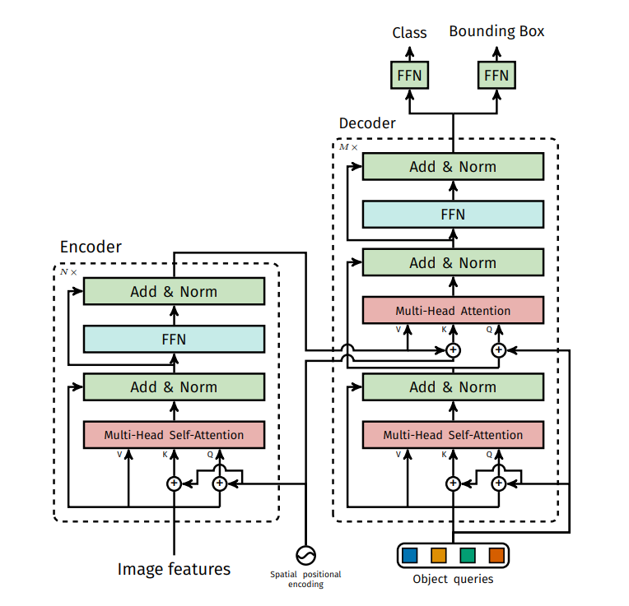
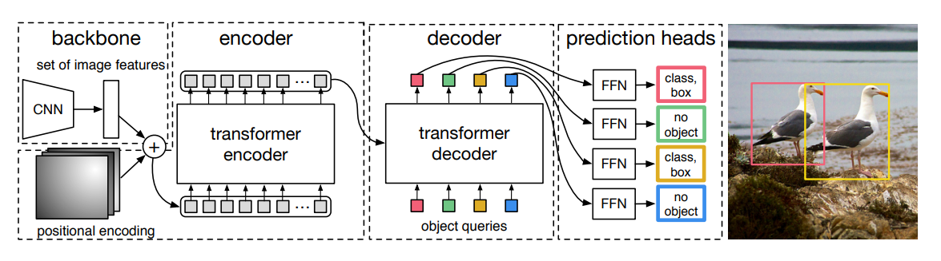
DETR

